Slide 1



Integrated Program in Business Analytics
World Military Expenditure and India’s Position
Group F
Presentation for: IPBA IIM Indore Jigsaw Academy

Slide 2

Table of Contents
Declaration
Go through the World Military Expenditure
Understanding the region-wise military expenditure
Go through Military Expenditure Per Capita Income of the countries
Go through the Share of GDP on Military Expenditure
Govt. Spending on Military Expenditure
Changes in Military Expenditure
Forecasting - India
Forecasting - USA
Web Application
External Sources
ReadMe

Slide 3

Declaration
A. Objective
The focus is to explain the trend in the world on the military expenditure with various angles. Going through the world digging into the region and then finally India and few key players position and forecasting
B. Approach
Consuming data and presenting them in various charts and bring down the eye catching facts.
C. Scope
Basically we are taking the data for World Military expenditure provided by SIPRI which is a reliable source of data. Analyzing and forecasting for India and USA
D. Tools
We have used Angular, Bootstrap, PrimeNG, Tableau, ChartJS, Python, R and other supporting tools like GitHub etc.
Note !
The actual presentation will include web application as well.. The respective analysis/insights/comments/captions will be auto-played &/ will be spoken. Hence this ppt contains graphical content maily.

Slide 4


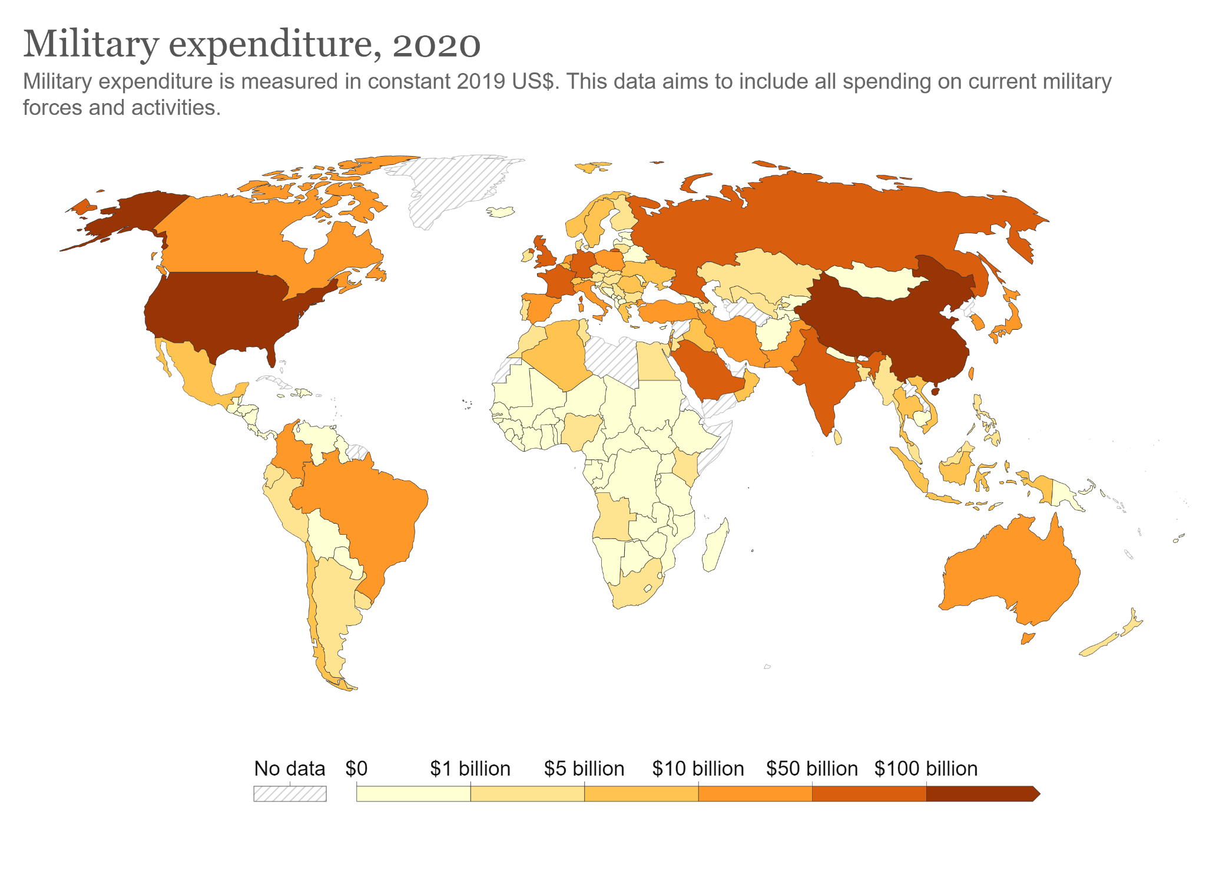
Russia
USA
China
II. Go through the World Military Expenditure
IN

Slide 5
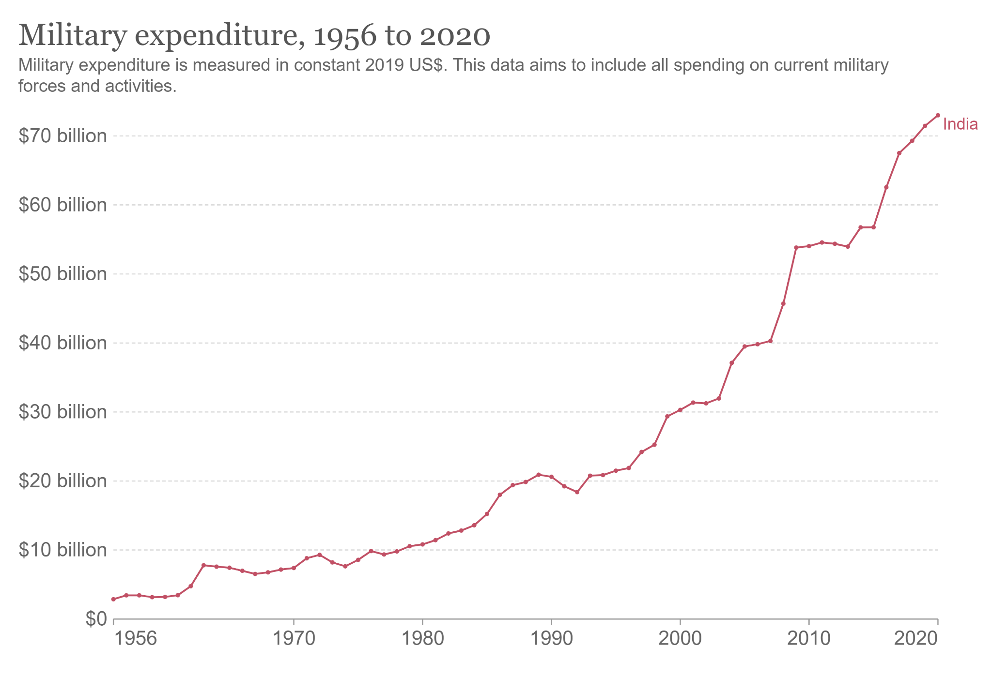
Hockey-stick climb observed from 2014 with Modi Govt.

Slide 6
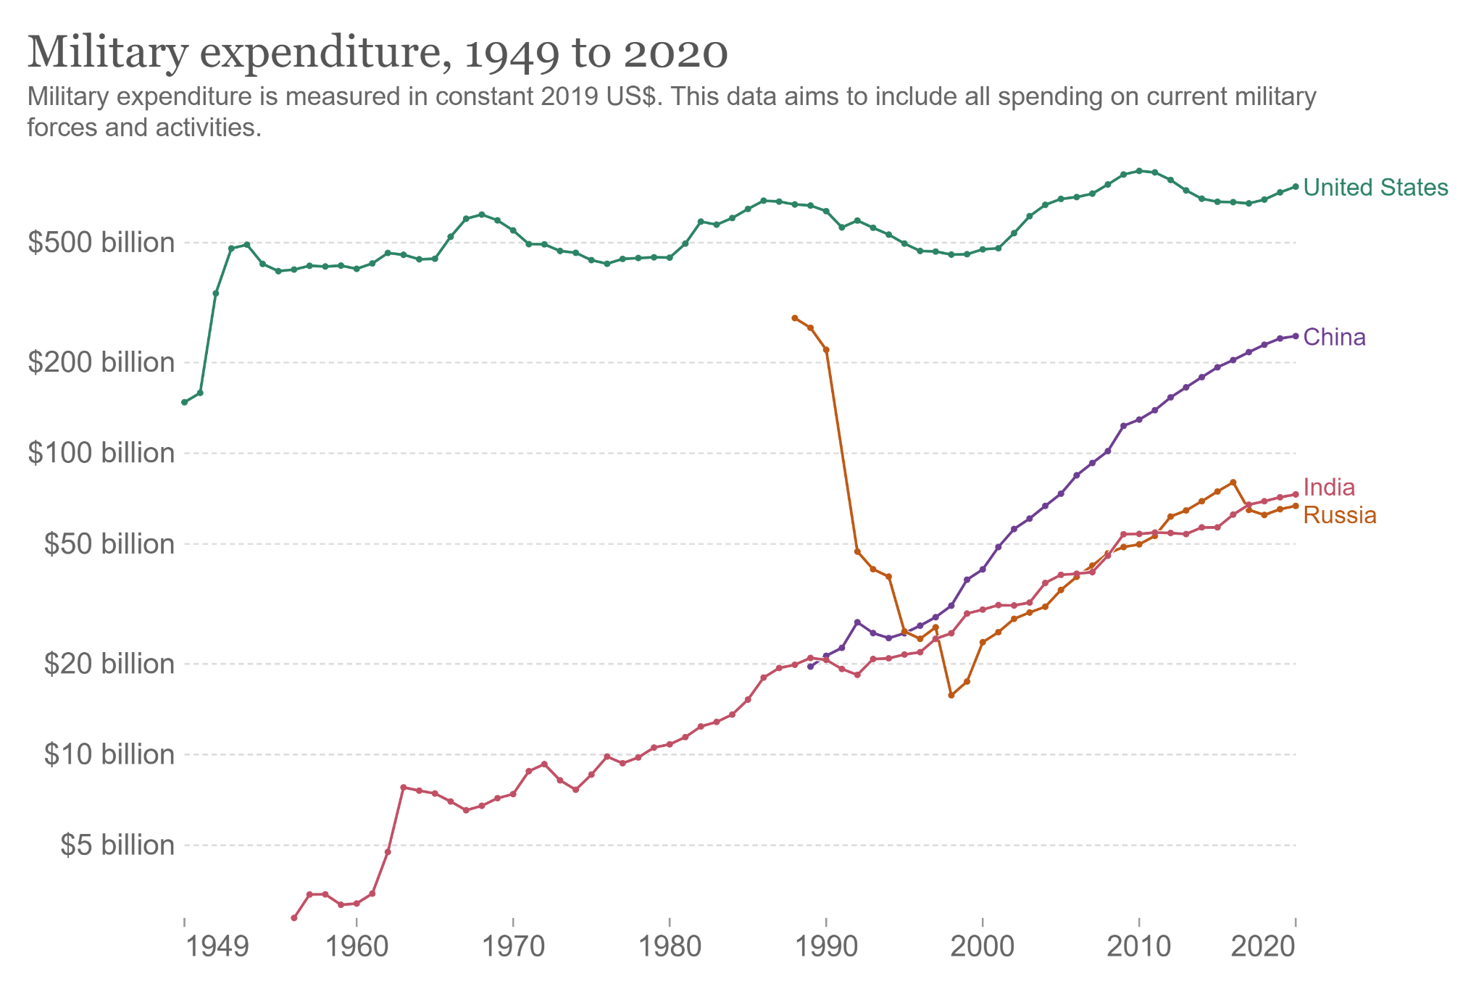

Slide 7
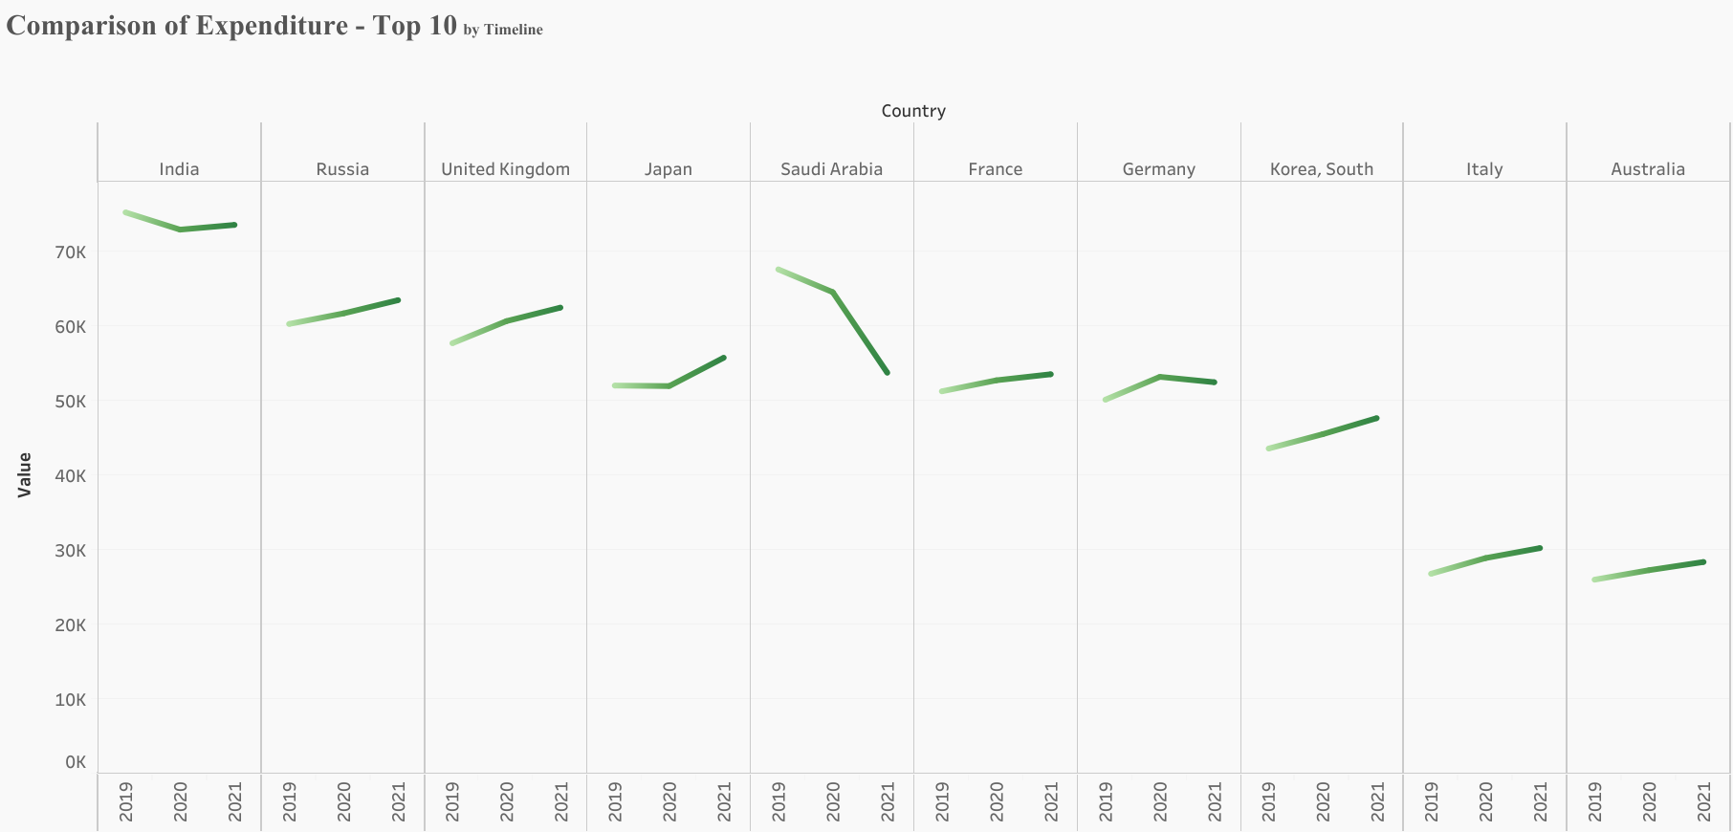
Saudi Arabia reduced spending due to Covid impact as it suffered from heavy oil export issues

Slide 8
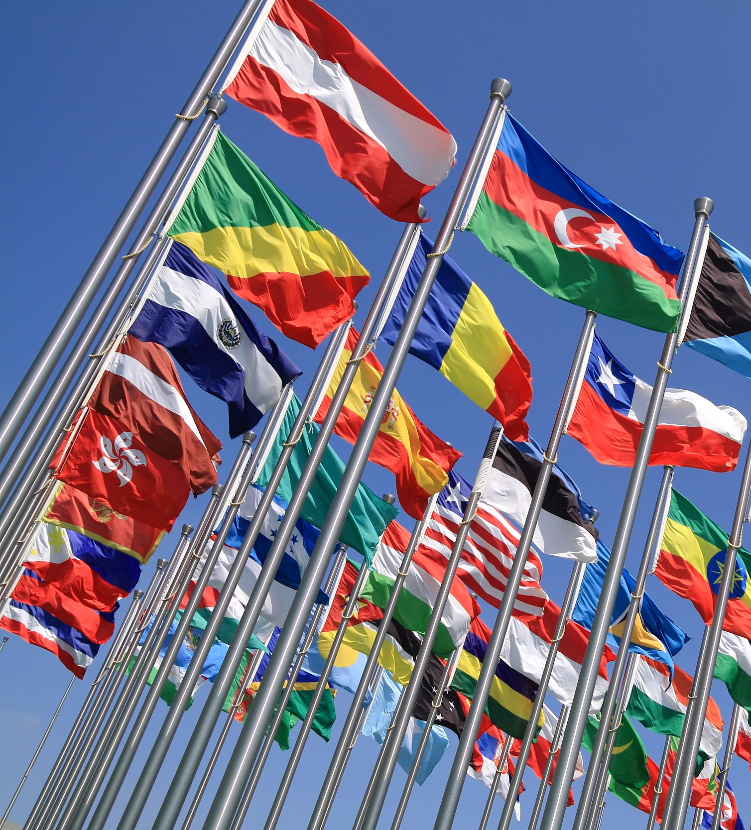
III. Understanding the region-wise military expenditure
Military Expenditure Region-wise in 2020
Asia
Africa
Europe
N. America
S. America

Slide 9
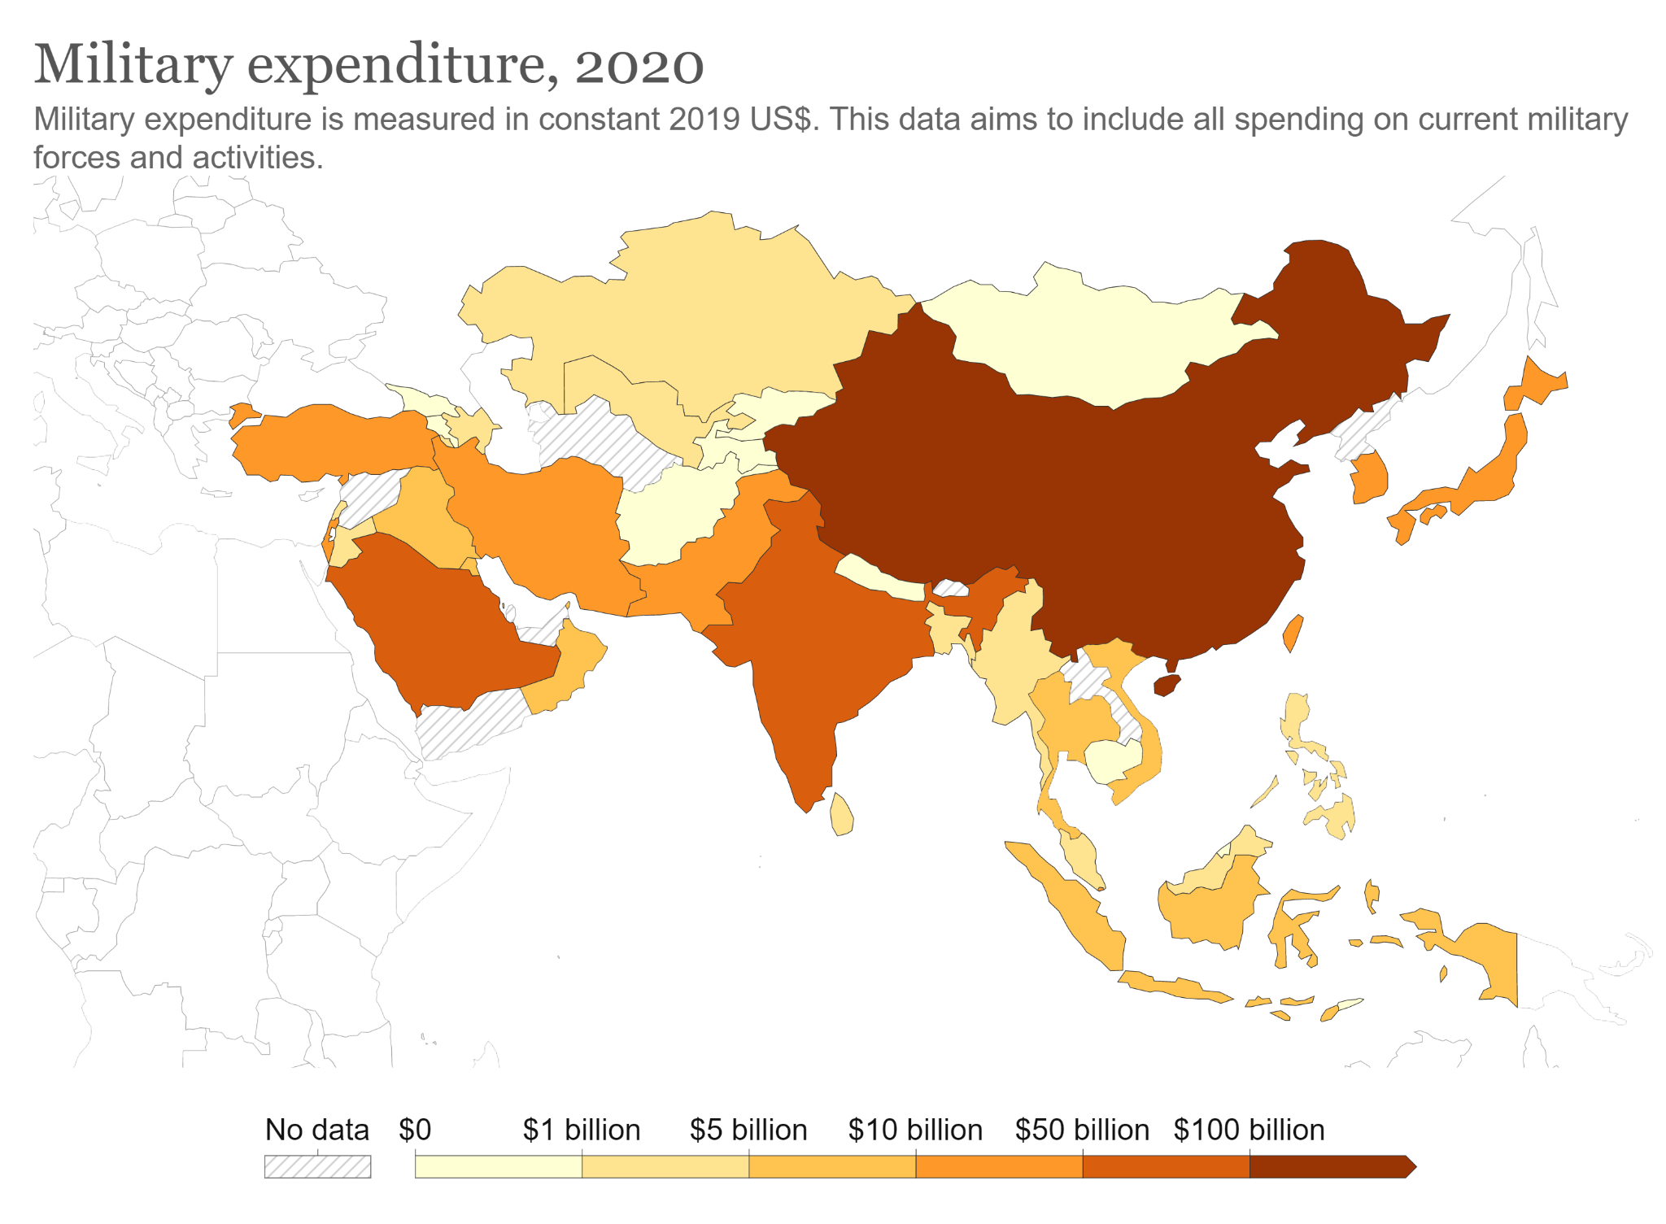
$ 244.93 billion
$ 12.15
billion
$ 10.1 billion
Asia
$ 55.53 billion
$ 73 billion
India’s ME is 7 times of the Pakistan’s
China, Saudi Arabia and India are the key players here

Slide 10
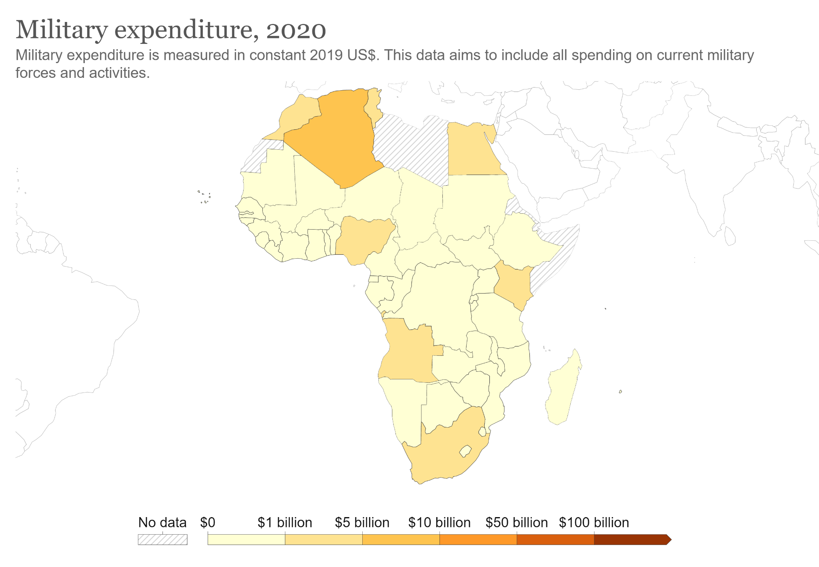
Africa
The most resourceful area in
terms of minerals
but the ME ranges below $10 billion in the region!

Slide 11
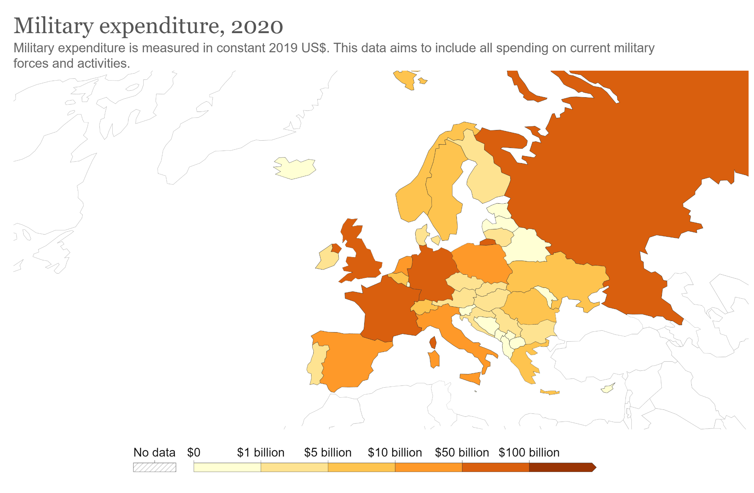
Russia, France and Germany are the biggest players here.
Ukraine is spent $6 billion and russia is spent $66.84 billion which is 11 times higher (Russia is about 28 times bigger than Ukraine.)
Europe

Slide 12
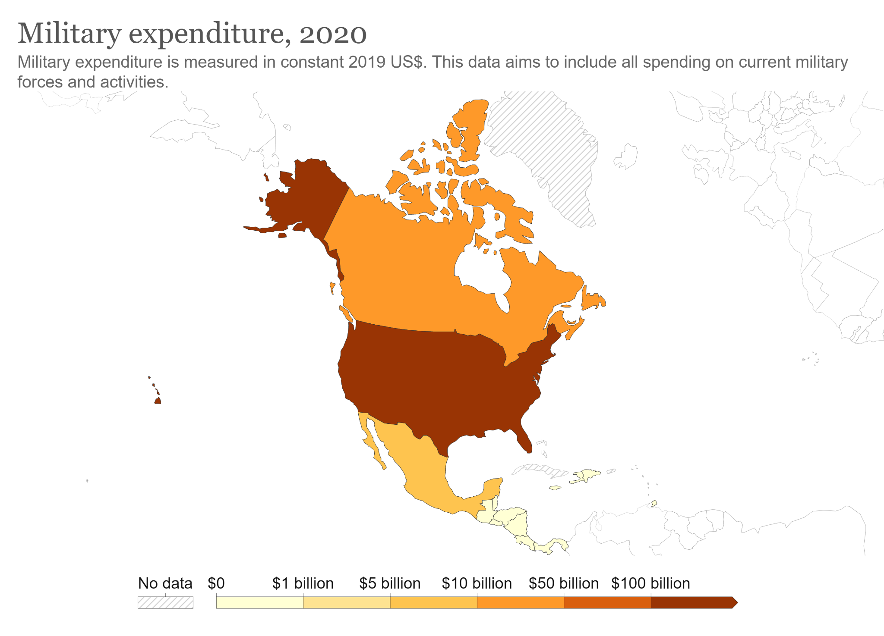
North America
USA: $766.58 billion
Canada: $22.85 billion
Mexico: $6.61 billion

Slide 13
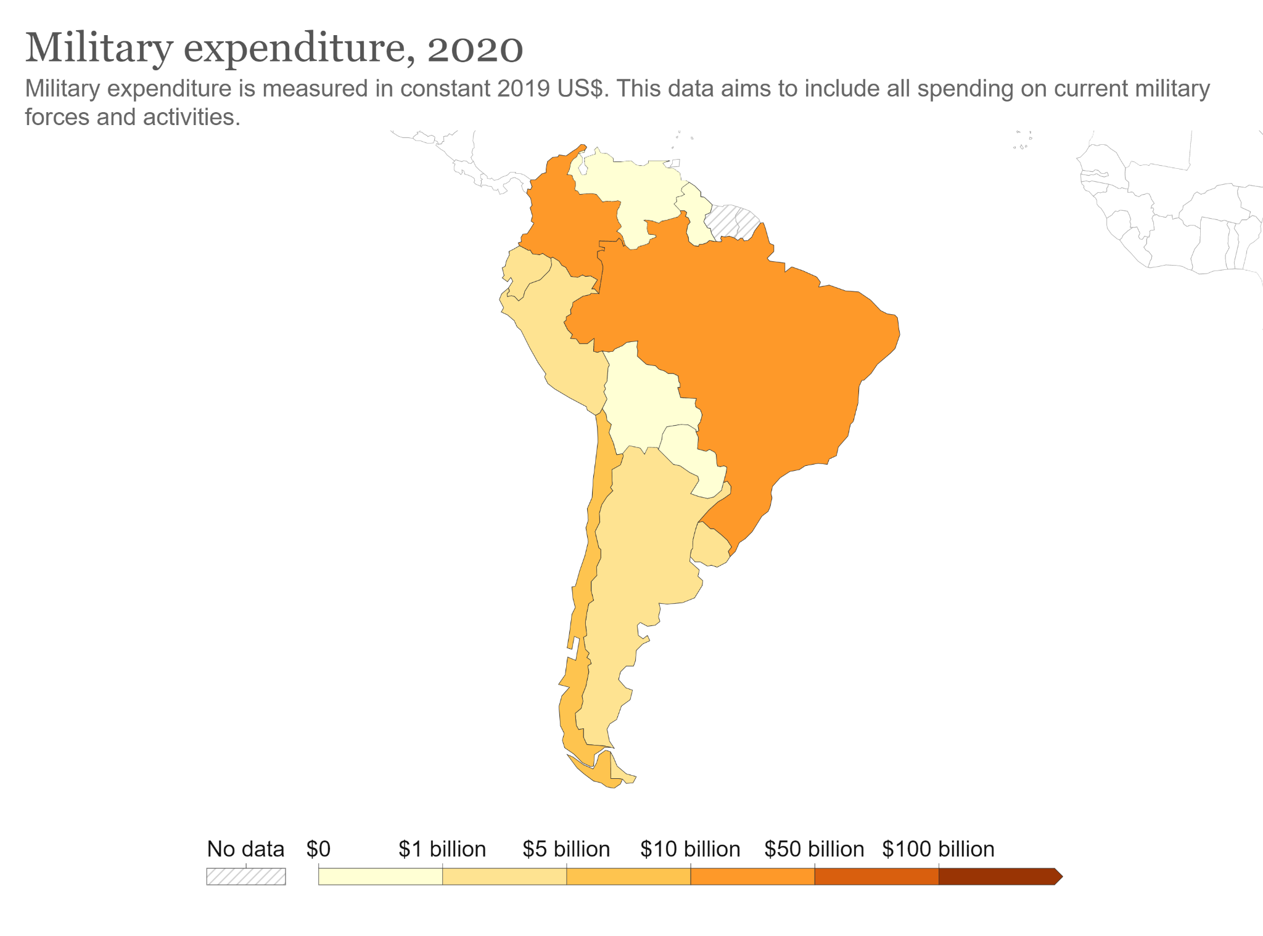
Brazil: $25.1 billion is the highest spender in the region
Venezuela: the country's natural resources include petroleum, natural gas, iron ore, gold, bauxite, diamonds and other minerals
Yet near to USA it’s spending a few ~$4L and that’s surprising.
It’s economy is draining (!)
South America

Slide 14
IV. Go through Per Capita Income of the countries
We will now go through the per capita income to military expenditure
World One way to look is as a whole world
Top 10 Let us filter out the top 10 countries bt their military expenditure in 2021 and put the per capita income as a reference to understand the situation
Military Expenditure Per Capita Income

Slide 15
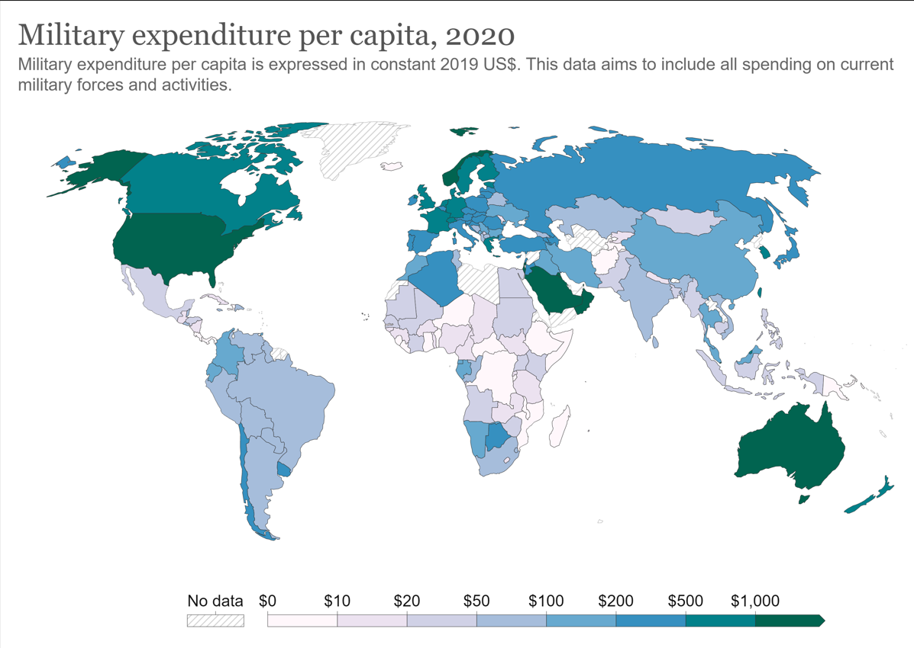
USA, Saudi Arabia, Australia and Norway are the top countries spending for per capita on ME.
Though China is spending more, due to higher population it is spending a double than India per head

Slide 16
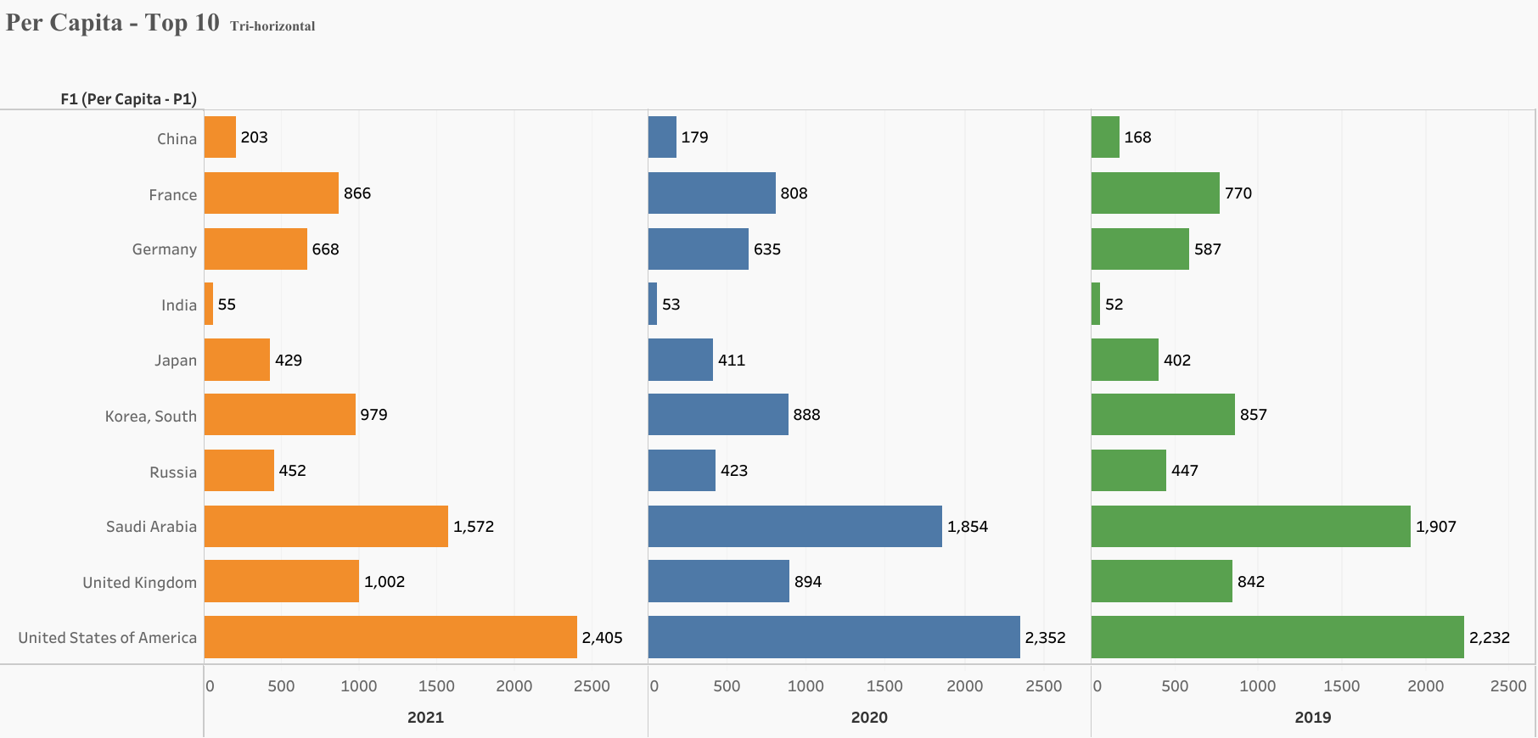

Slide 17
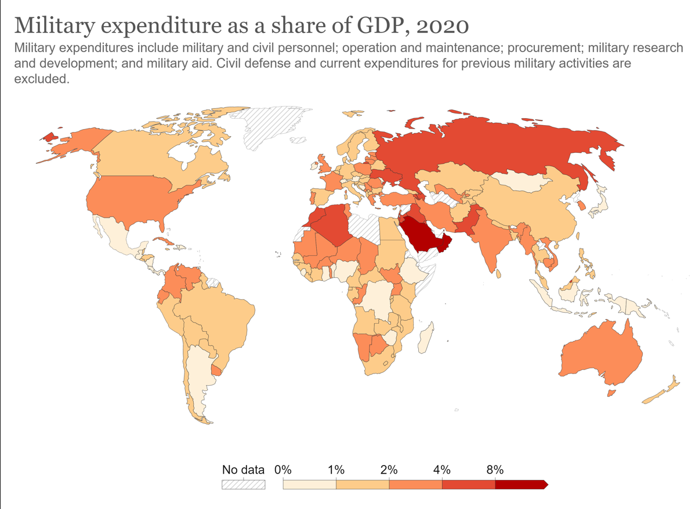
V. Go through the Share of GDP on Military Expenditure

Slide 18
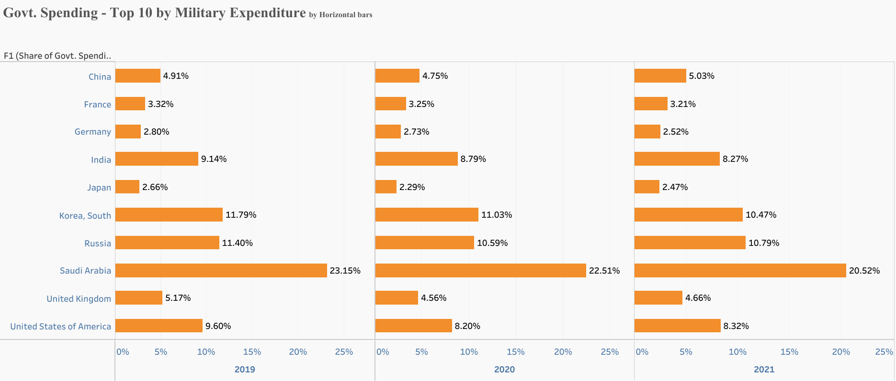
VI. Govt. Spending on Military Expenditure

Slide 19
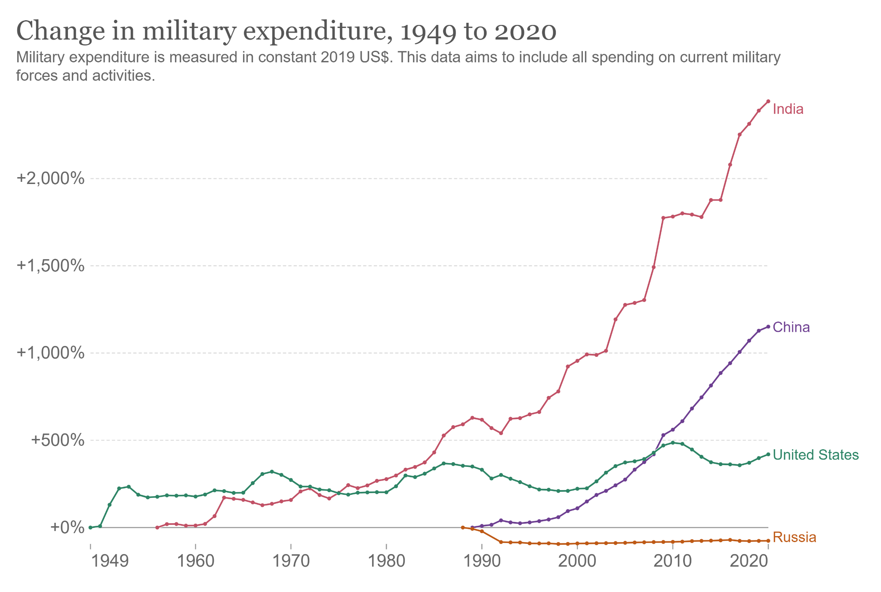
VII. Comparison on Expenditure and Share of GDP

Slide 20
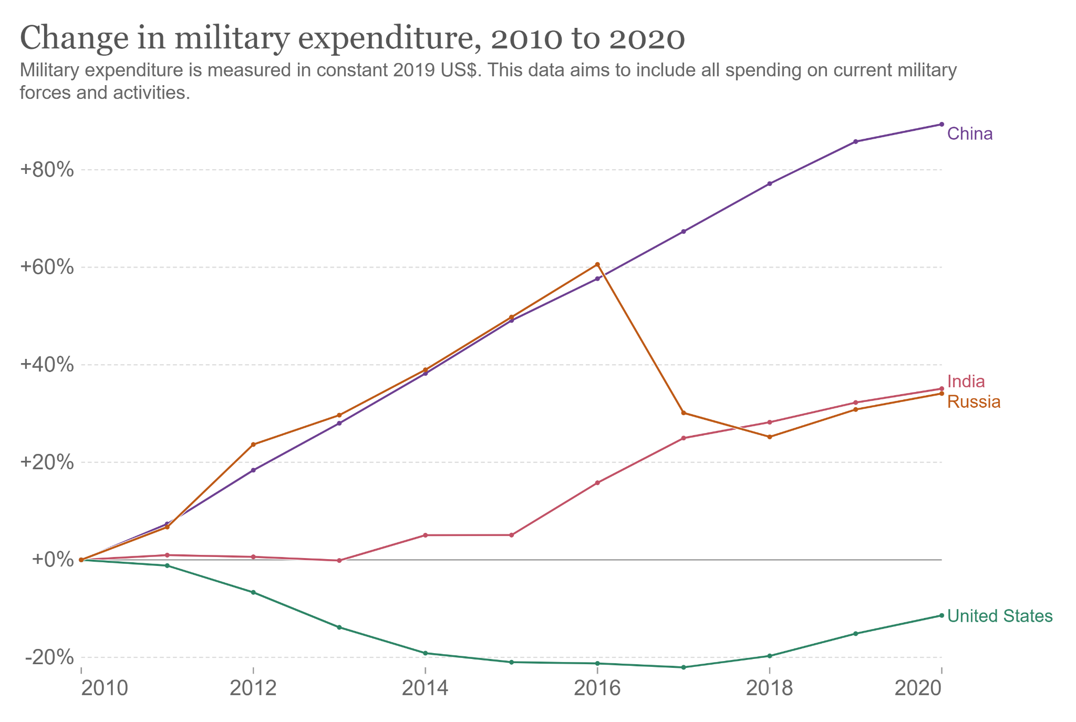

Slide 21
VIII. Forecasting - India
Forecasting India’s Military Expenditure

Slide 22
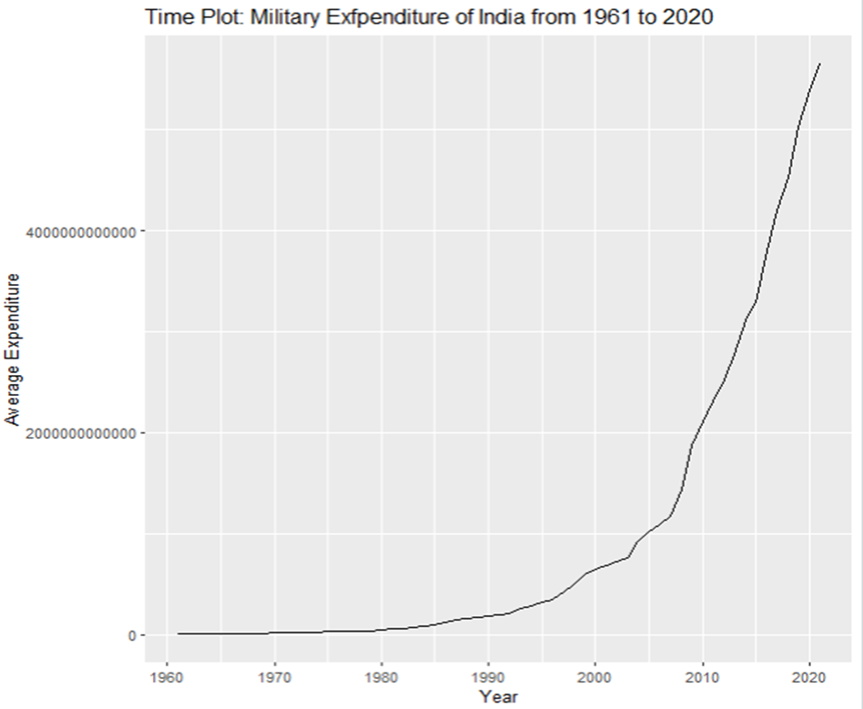
Graph

Slide 23
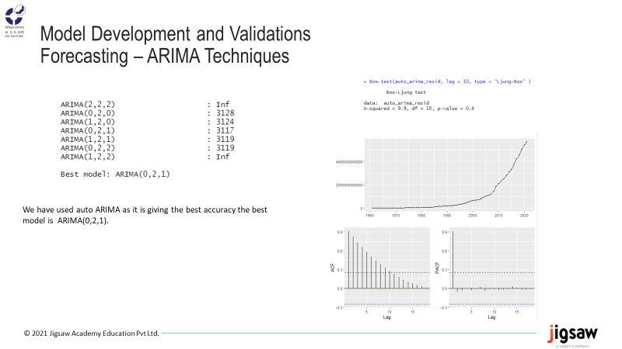

Slide 24
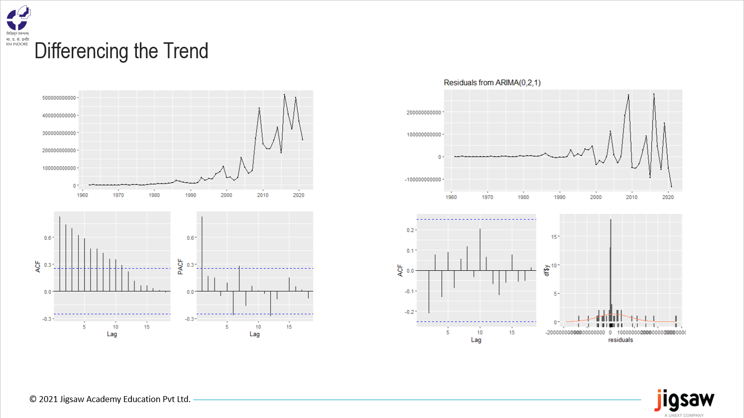

Slide 25
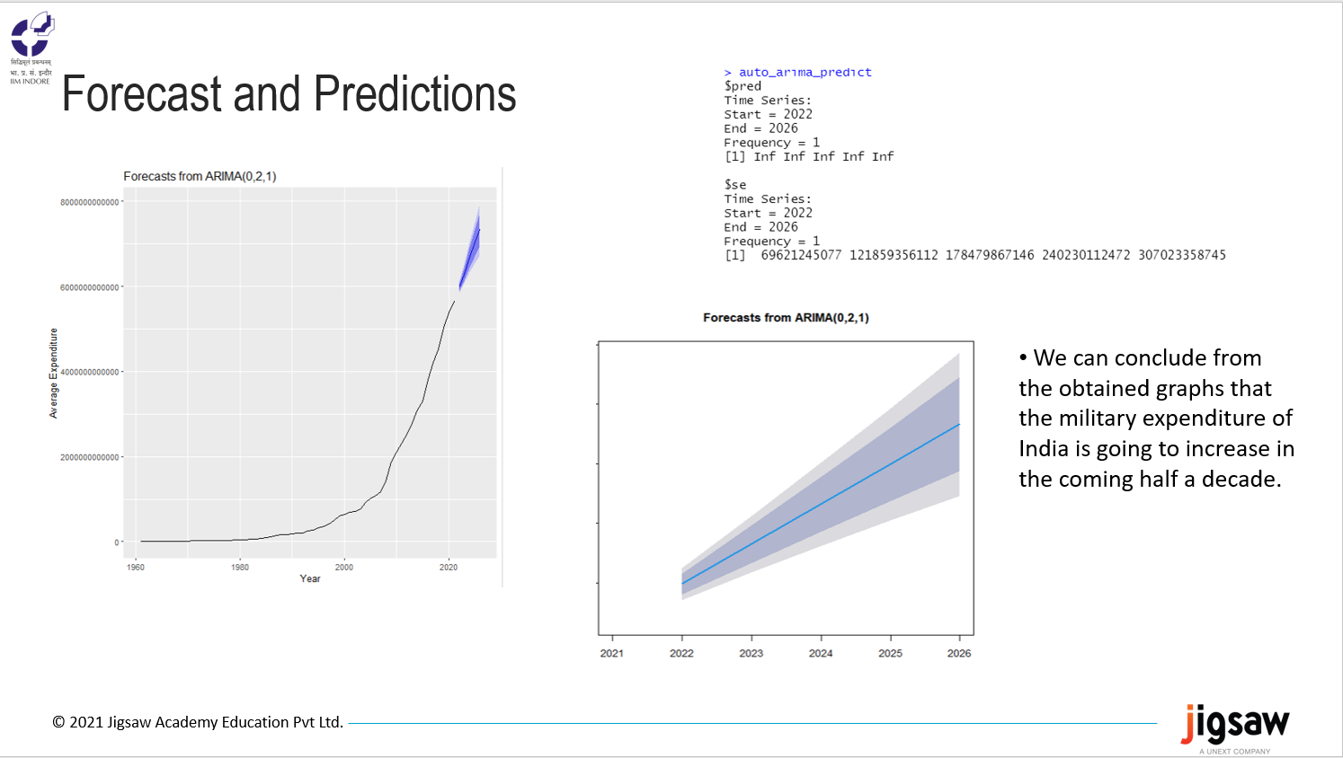

Slide 26
IX. Forecasting - USA
Forecasting USA’s Military Expenditure USA 2000 to 2021

Slide 27
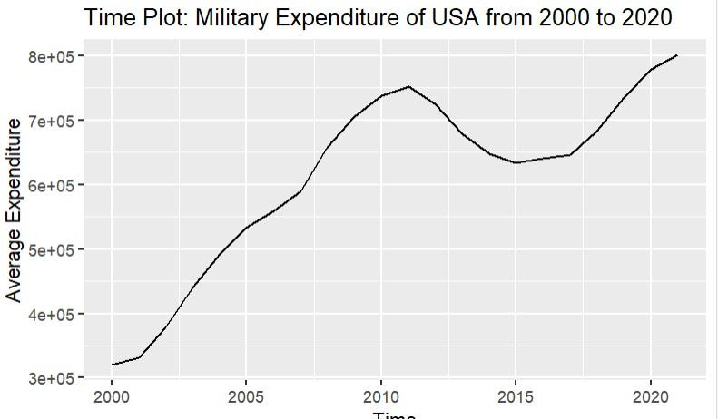

Slide 28
ARIMA (2,1,2) with drift | Inf
ARIMA (0,1,0) with drift | 498.2421
ARIMA (1,1,0) with drift | 482.3841
ARIMA (0,1,1) with drift | 483.4487
ARIMA (0,1,0) | 505.0536
ARIMA (2,1,0) with drift | 477.6094
ARIMA (3,1,0) with drift | 481.1091
ARIMA (2,1,1) with drift | 481.1086
ARIMA (1,1,1) with drift | 479.0843
ARIMA (3,1,1) with drift | 484.782
ARIMA (2,1,0) | 476.9104
ARIMA (1,1,0) | 481.0851
ARIMA (3,1,0) | 479.9187
ARIMA (2,1,1) | 479.8598
ARIMA (1,1,1) | 477.544
ARIMA (3,1,1) | 483.0105
Best model: ARIMA (2,1,0) | Best model: ARIMA (2,1,0)
Model Development and Validations
Forecasting – ARIMA Techniques Box-Ljung test

Slide 29
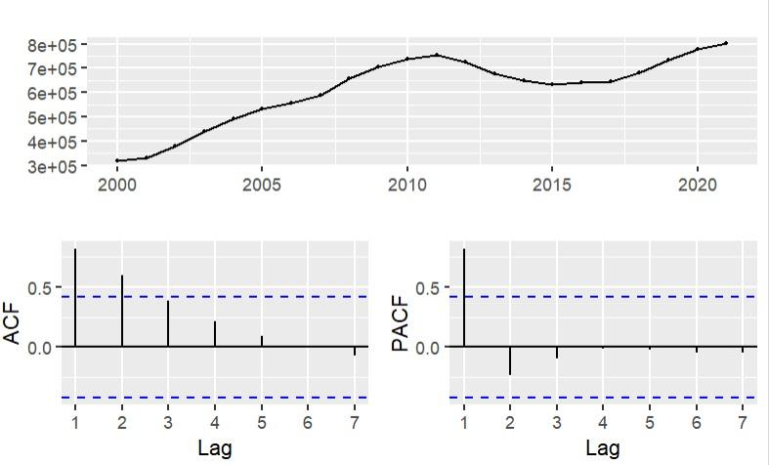
X-squared = 5.792, df = 10, p-value = 0.8324

Slide 30
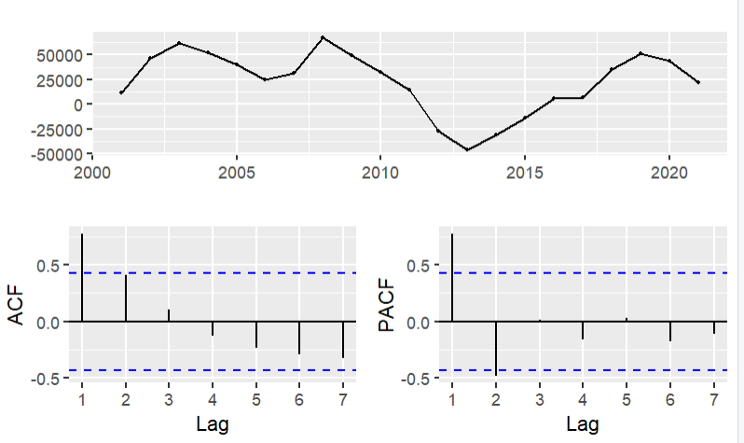
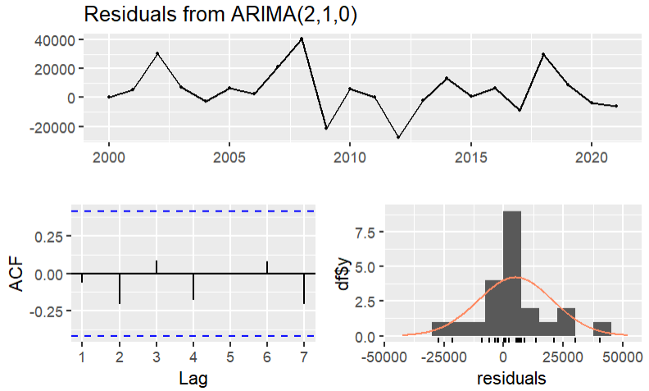
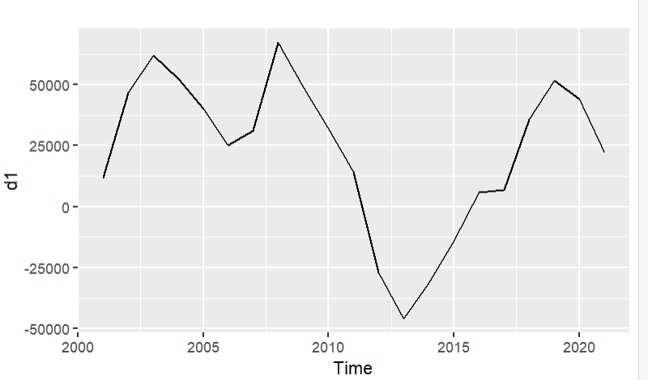
Model Development and Validations

Slide 31
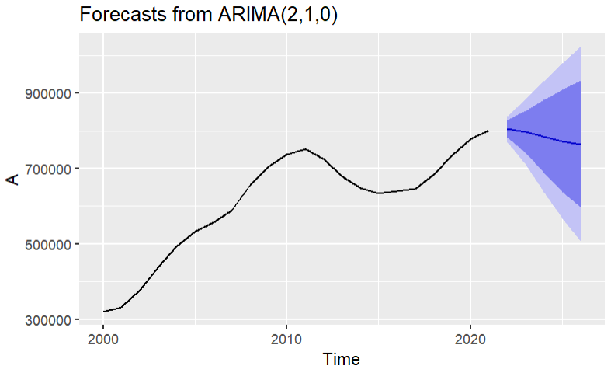
We can conclude from the
obtained graphs that the military expenditure of United States of America is going to reduce in the coming half a decade.

Slide 32
Note: But there are high chances of variation due to Ukraine-Russia conflict and can result in temporary spike in the military expenditure

Slide 33
You can reach out to explore more on web application at World Military Expenditure (in progress)
X. Web Application

Slide 34
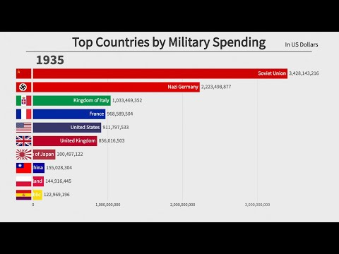
XI. External Sources

Slide 35

XII. Readme
The SIPRI Military Expenditure Database contains consistent time series on the military spending of countries for the period 1949–2021. The database is updated annually, which may include updates to data for any of the years included in the database.
Military expenditure in local currency at current prices is presented according to both the financial year of each country and according to calendar year, calculated on the assumption that, where financial years do not correspond to calendar years, spending is distributed evenly through the year. Figures in constant (2020) and current US dollars, as a share of gross domestic product (GDP) and per capita are presented according to calendar year. Figures given as a share of government expenditure are presented according to financial year.
The availability of data varies considerably by country, but for a majority of countries that were independent at the time, data is available from at least the late 1950s. Estimates for regional military expenditure have been extended backwards depending on availability of data for countries in the region, but no estimates for total world military expenditure are available before 1988 due to the lack of data for the Soviet Union.

Slide 36
Many Thanks
Indian Institute of Management - Indore Jigsaw Academy Stockholm International Peace Research Institute Esp. Mr. Akbar to guide us
From Darshan Bhavsar Chaitanya Manvi Kushagra Harshal Shashank

